Slide 1
.net core 6
Sarita Lad
DATE

Slide 2
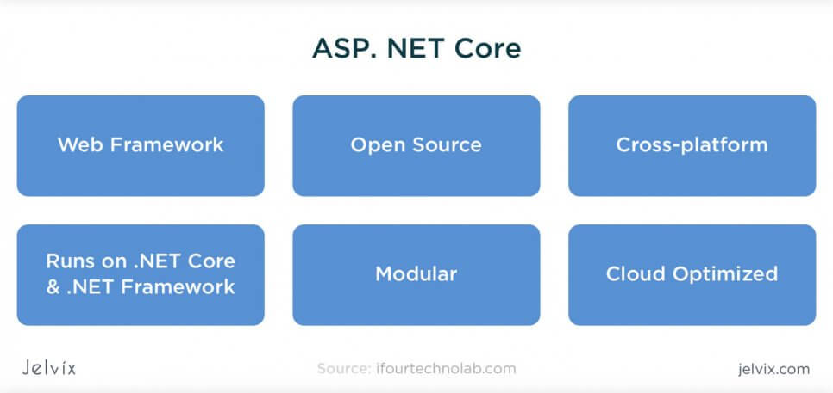
What is .net core ?
ASP Core is a new version of ASP that became available open-source and can be executed not only on Windows but also on Linux and Mac. With this update, ASP.NET became increasingly more available to teams who usually work outside of the Microsoft ecosystem.

Slide 3
What is there in .net core 6?
NET 6 is the fastest full stack web framework, which lowers compute costs if you're running in the cloud. Ultimate productivity: . NET 6 and Visual Studio 2022 provides follwing features
hot reload
new git tooling
intelligent code editing,
robust diagnostics
testing tools
better team collaboration
Cloud enabled code

Slide 4
.net Evolution chart
Version Number | Release Date | End of Support | Supported Visual Studio Version(s)
1.0 | 2016-06-27 | 2019-06-27 | Visual Studio 2015, 2017
1.1 | 2016-11-18 | 2019-06-27 | Visual Studio 2015, 2017
2.0 | 2017-08-14 | 2018-10-01 | Visual Studio 2017
2.1 long-term support | 2018-05-30 | 2021-08-21^{[7]} | Visual Studio 2017
2.2 | 2018-12-04^{[8]} | 2019-12-23^{[9]} | Visual Studio 2017 15.9 and 2019 16.0 preview 1
3.0 | 2019-09-23^{[10]} | 2020-03-03^{[9]} | Visual Studio 2017 and 2019
3.1 long-term support | 2019-12-03^{[11]} | 2022-12-03^{[9]} | Visual Studio 2019
5.0 | 2020-11-10^{[12]} | 2022-05-08 | Visual Studio 2019 16.8
6.0 long-term support | 2021-11-08^{[13]} | 2024-11-08 | Visual Studio 2022

Slide 5
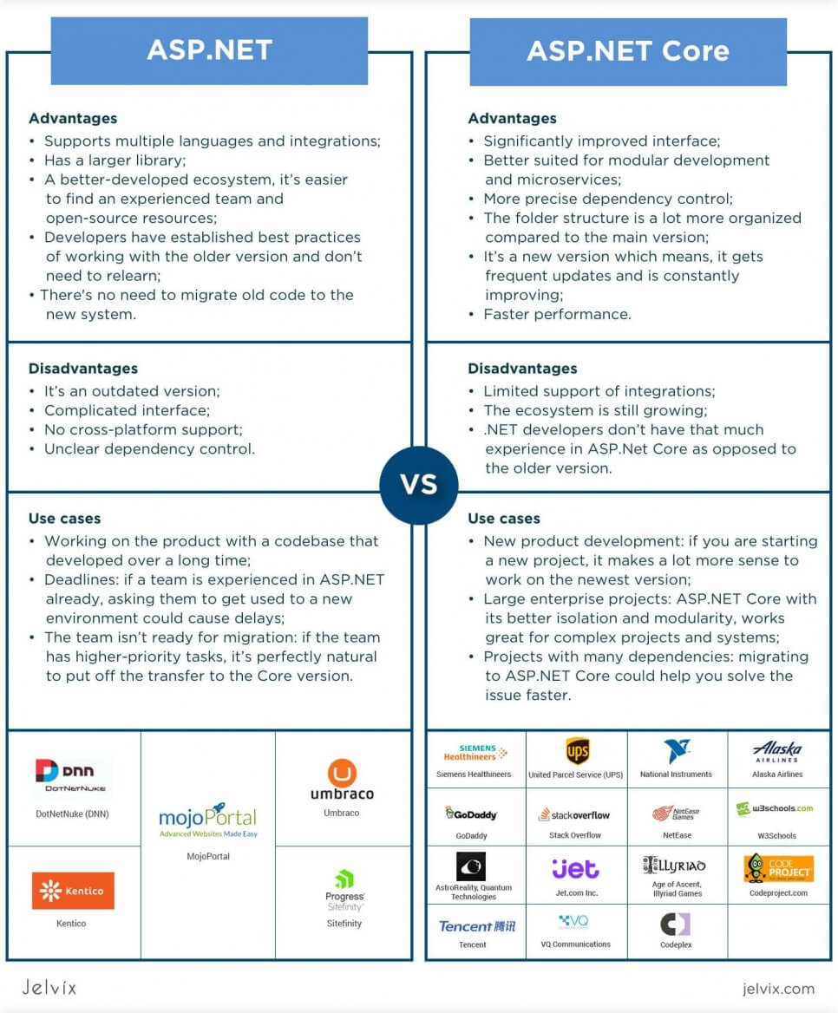
What is the difference between ASP.NET and ASP.NET Core?

Slide 6
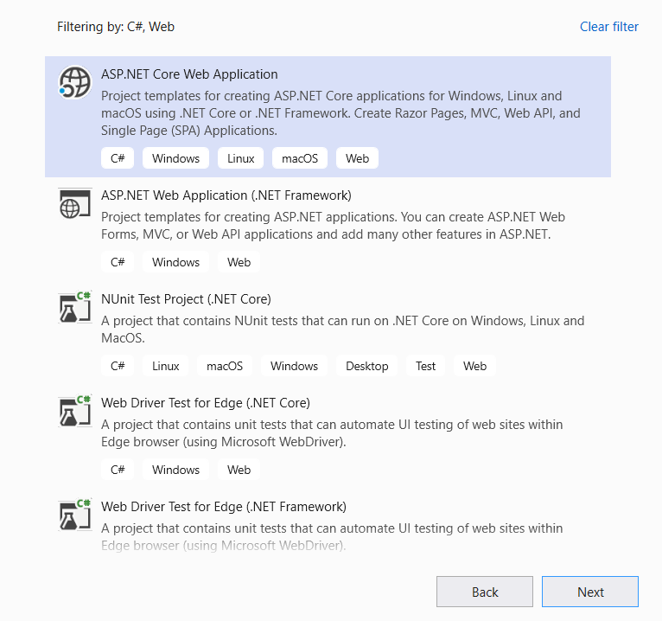
.net Project templates

Slide 7
Difference between .net core and .net standard
.NET Core: This is the latest .NET implementation. It’s open source and available for multiple OSes. With .NET Core, you can build cross-platform console apps and ASP.NET Core Web applications and cloud services.
.NET Standard: This is the set of fundamental APIs (commonly referred to as base class library or BCL) that all .NET implementations must implement. By targeting .NET Standard, you can build libraries that you can share across all your .NET apps, no matter on which .NET implementation or OS they run.

Slide 8
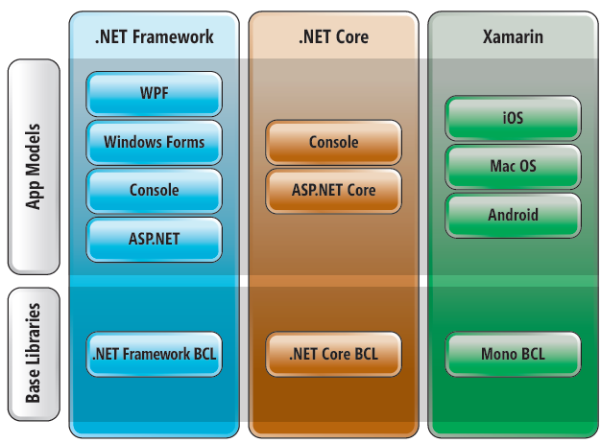

Slide 9
Where does .net standard Stand in 3 frameworks .net,.net core and xamarin
 | OS | Open Source | Purpose
.NET Framework | Windows | No | Used for building Windows desktop applications and ASP.NET Web apps running on IIS.
.NET Core | Windows, Linux, macOS | Yes | Used for building cross-platform console apps and ASP.NET Core Web apps and cloud services.
Xamarin | iOS, Android, macOS | Yes | Used for building mobile applications for iOS and Android, as well as desktop apps for macOS.
.NET Standard | N/A | Yes | Used for building libraries that can be referenced from all .NET implementations, such as .NET Framework, .NET Core and Xamarin.

Slide 10
Dotnet CLI interface
C:\>dotnet –version
Dotnet new console –name mycosoleapp1
dotnet new console --name myconsoleapp23 --framework net5.0
dotnet new razor --name myrazorapp
dotnet new console --language "F#“
dotnet new classlib --framework "netstandard2.0" -o MyLibrary
dotnet new mvc -au None
Dotnet build
Dotnet run

Slide 11
Thank You

